Slide 1

City of Fontana Redistricting 2021-2022
Todd Tatum
National Demographics Corporation

Slide 2
Redistricting Process
Step | Description
Two Initial Hearings October 12 & October 26 | Held prior to release of draft maps. Education and to solicit input on the communities in the Districts.
Census Data Release Mid/Late August | Census Bureau releases official 2020 Census population data.
California Data Release Early October 2021 | California Statewide Database releases California’s official ‘prisoner-adjusted’ 2020 redistricting data.
Two Draft Map Hearings January 25 & March 8 | Two Public Hearings to discuss and revise the draft maps and to discuss the election sequence.
Map Adoption By April 17, 2022 | Final map must be posted at least 7 days prior to adoption. Map adopted via ordinance.*
*SB 594 would explicitly confirm maps may be adopted by resolution.

Slide 3
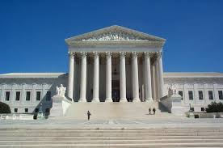
Redistricting Rules and Goals
1. Federal Laws
2. California Criteria for Cities (rank ordered)
3. Other Traditional Redistricting Principles
Equal Population
Federal Voting Rights Act
No Racial Gerrymandering
Geographically contiguous
Undivided neighborhoods and “communities of interest” (Socio-economic geographic areas that should be kept together)
Easily identifiable boundaries
Compact (Do not bypass one group of people to get to a more distant group of people)
Prohibited:
“Shall not favor or discriminate against a political party.”
Minimize voters shifted to different election years
Respect voters’ choices / continuity in office
Future population growth
Preserving the core of existing districts

Slide 4
Initial Draft Maps
Three initial draft maps have been developed by NDC, and 2 draft maps submitted from the Public.
All of the maps created by NDC have a deviation under the required 10%.
NDC Map 101 has a deviation of 3.85%
NDC Map 102 has a deviation of 4.70%
NDC Map 103 has a deviation of 4.28%
Public Map 104 has a deviation of 3.43%
Public Map 401 has a deviation of 4.78%
Public Map 402 has a deviation of 4.93%
Public Map 403 has a deviation of 0.11%
Public Map 601 has a deviation of 21.49% (a 6 district Map)
Existing Districts deviation is 12.16%

Slide 5
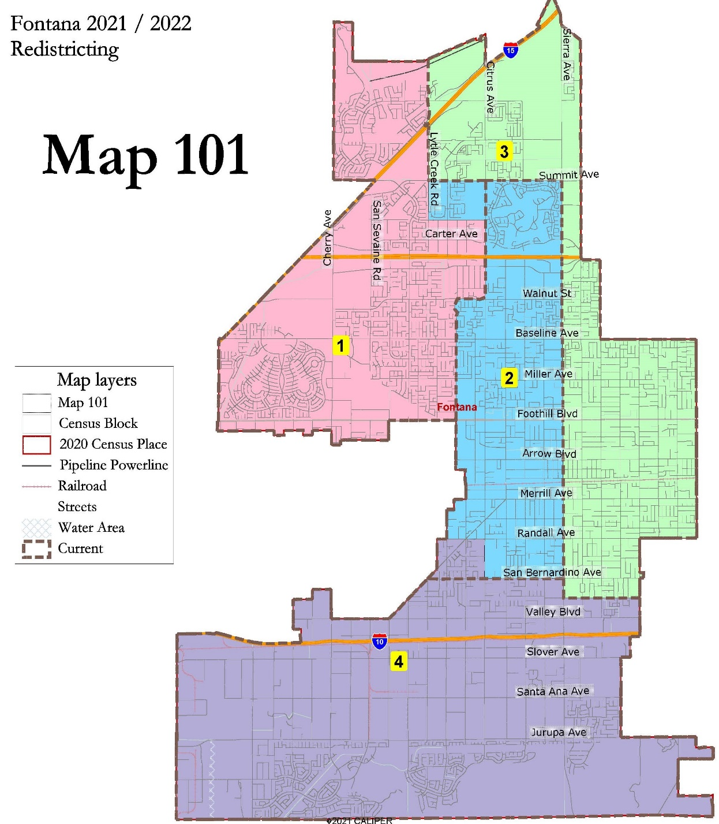
NDC Draft Map 101

Slide 6
NDC Map 101 Demographics
Fontana Map 101
District |  | 1 | 2 | 3 | 4 | Total
 | Total Pop | 52,751 | 53,041 | 52,237 | 51,031 | 209,060
 | Deviation from ideal | 486 | 776 | -28 | -1,234 | 2,010
 | % Deviation | 0.93% | 1.48% | -0.05% | -2.36% | 3.85%
Total Pop | % Hisp | 47.9% | 72% | 75% | 76% | 68%
 | % NH White | 20% | 9% | 12% | 8% | 12%
 | % NH Black | 13% | 9% | 6% | 7% | 9%
 | % Asian-American | 15% | 8% | 5% | 7% | 9%
Citizen Voting Age Pop | Total | 34,285 | 26,950 | 28,076 | 32,285 | 121,597
 | % Hisp | 49% | 67% | 69% | 69% | 63%
 | % NH White | 22% | 16% | 19% | 13% | 18%
 | % NH Black | 17% | 9% | 7% | 11% | 11%
 | % Asian/Pac.Isl. | 10% | 7% | 4% | 5% | 7%
Voter Registration (Nov 2020) | Total | 31,188 | 21,928 | 25,280 | 24,571 | 102,967
 | % Latino est. | 45% | 63% | 67% | 70% | 60%
 | % Spanish-Surnamed | 40% | 58% | 61% | 63% | 54%
 | % Asian-Surnamed | 5% | 3% | 2% | 2% | 3%
 | % Filipino-Surnamed | 3% | 3% | 2% | 2% | 2%
 | % NH White est. | 30% | 22% | 26% | 17% | 24%
 | % NH Black | 21% | 13% | 9% | 14% | 15%
Voter Turnout (Nov 2020) | Total | 24,958 | 15,394 | 17,922 | 17,832 | 76,106
 | % Latino est. | 43% | 60% | 65% | 68% | 57%
 | % Spanish-Surnamed | 39% | 55% | 59% | 61% | 52%
 | % Asian-Surnamed | 4% | 3% | 2% | 3% | 3%
 | % Filipino-Surnamed | 3% | 3% | 2% | 2% | 2%
 | % NH White est. | 31% | 23% | 27% | 17% | 25%
 | % NH Black | 21% | 14% | 9% | 15% | 16%

Slide 7
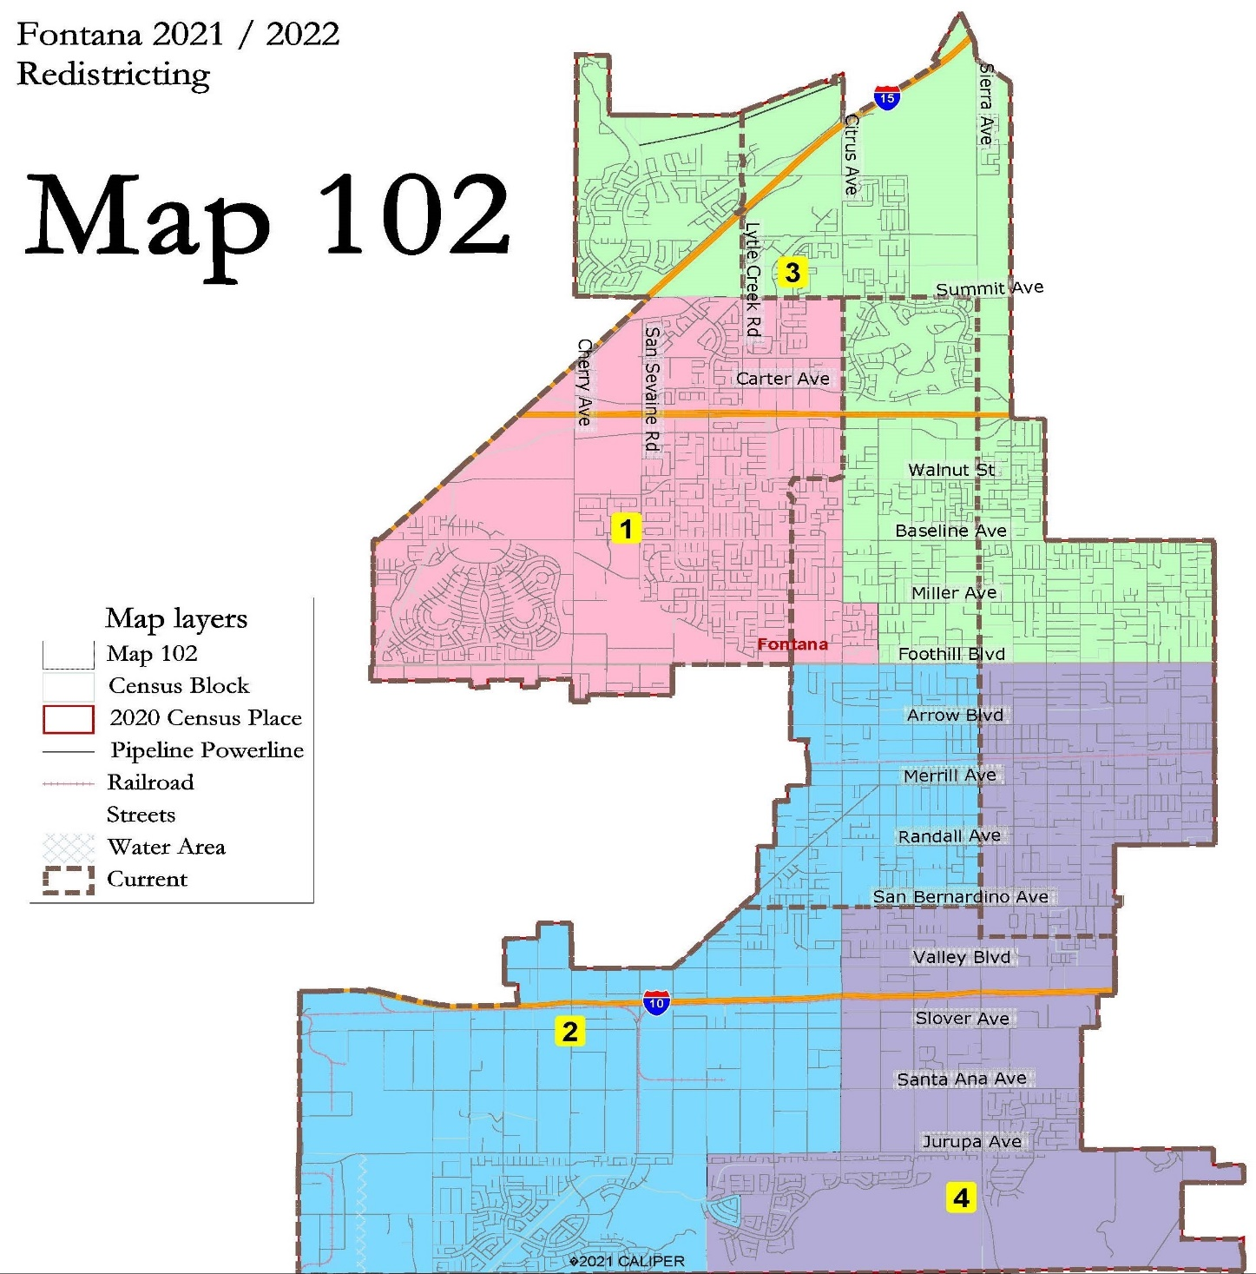
NDC Draft Map 102

Slide 8
NDC Map 102 Demographics
Fontana Map 102
District |  | 1 | 2 | 3 | 4 | Total
 | Total Pop | 52,259 | 52,411 | 50,966 | 53,424 | 209,060
 | Deviation from ideal | -6 | 146 | -1,299 | 1,159 | 2,458
 | % Deviation | -0.01% | 0.28% | -2.49% | 2.22% | 4.70%
Total Pop | % Hisp | 51.4% | 82% | 61% | 76% | 68%
 | % NH White | 17% | 7% | 16% | 10% | 12%
 | % NH Black | 14% | 6% | 10% | 7% | 9%
 | % Asian-American | 15% | 3% | 11% | 5% | 9%
Citizen Voting Age Pop | Total | 33,385 | 28,340 | 28,835 | 31,036 | 121,597
 | % Hisp | 54% | 76% | 57% | 66% | 63%
 | % NH White | 18% | 13% | 22% | 17% | 18%
 | % NH Black | 17% | 9% | 9% | 11% | 11%
 | % Asian/Pac.Isl. | 9% | 2% | 10% | 5% | 7%
Voter Registration (Nov 2020) | Total | 30,012 | 20,943 | 27,290 | 24,722 | 102,967
 | % Latino est. | 48% | 74% | 55% | 68% | 60%
 | % Spanish-Surnamed | 43% | 67% | 50% | 62% | 54%
 | % Asian-Surnamed | 5% | 1% | 4% | 2% | 3%
 | % Filipino-Surnamed | 3% | 1% | 3% | 2% | 2%
 | % NH White est. | 26% | 17% | 30% | 22% | 24%
 | % NH Black | 22% | 11% | 12% | 12% | 15%
Voter Turnout (Nov 2020) | Total | 23,634 | 14,148 | 20,679 | 17,645 | 76,106
 | % Latino est. | 46% | 72% | 53% | 66% | 57%
 | % Spanish-Surnamed | 42% | 66% | 48% | 60% | 52%
 | % Asian-Surnamed | 4% | 1% | 4% | 2% | 3%
 | % Filipino-Surnamed | 3% | 1% | 3% | 2% | 2%
 | % NH White est. | 27% | 18% | 31% | 22% | 25%
 | % NH Black | 22% | 11% | 13% | 13% | 16%

Slide 9
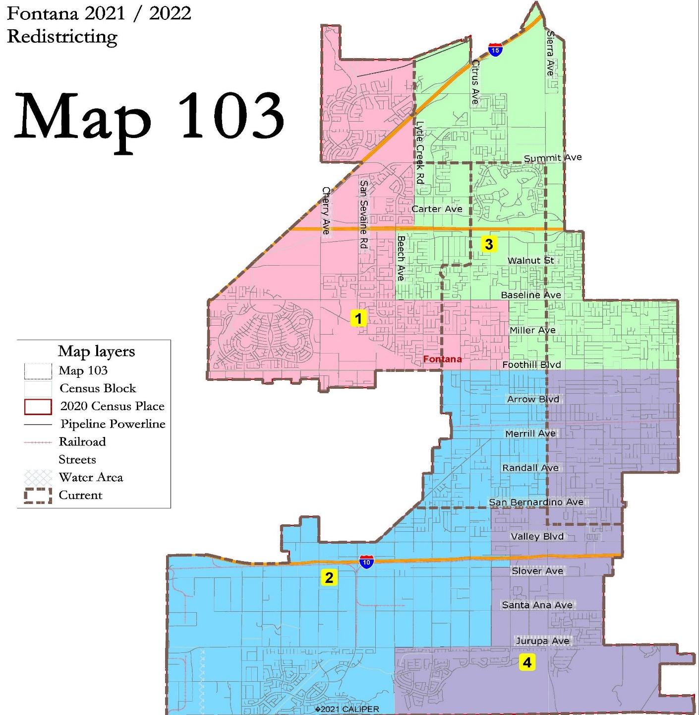
NDC Draft Map 103

Slide 10
NDC Map 103 Demographics
Fontana Map 103
District |  | 1 | 2 | 3 | 4 | Total
 | Total Pop | 52,363 | 52,735 | 50,862 | 53,100 | 209,060
 | Deviation from ideal | 98 | 470 | -1,403 | 835 | 2,238
 | % Deviation | 0.19% | 0.90% | -2.68% | 1.60% | 4.28%
Total Pop | % Hisp | 51.7% | 83% | 60% | 76% | 68%
 | % NH White | 19% | 7% | 14% | 10% | 12%
 | % NH Black | 12% | 6% | 11% | 7% | 9%
 | % Asian-American | 14% | 3% | 12% | 5% | 9%
Citizen Voting Age Pop | Total | 33,408 | 28,362 | 28,812 | 31,014 | 121,597
 | % Hisp | 51% | 76% | 60% | 66% | 63%
 | % NH White | 22% | 13% | 18% | 17% | 18%
 | % NH Black | 16% | 8% | 10% | 11% | 11%
 | % Asian/Pac.Isl. | 9% | 2% | 11% | 5% | 7%
Voter Registration (Nov 2020) | Total | 30,068 | 21,006 | 27,234 | 24,659 | 102,967
 | % Latino est. | 47% | 74% | 56% | 68% | 60%
 | % Spanish-Surnamed | 43% | 68% | 51% | 62% | 54%
 | % Asian-Surnamed | 4% | 1% | 4% | 2% | 3%
 | % Filipino-Surnamed | 3% | 1% | 3% | 2% | 2%
 | % NH White est. | 29% | 18% | 26% | 21% | 24%
 | % NH Black | 19% | 10% | 15% | 13% | 15%
Voter Turnout (Nov 2020) | Total | 23,868 | 14,173 | 20,445 | 17,620 | 76,106
 | % Latino est. | 46% | 72% | 53% | 66% | 57%
 | % Spanish-Surnamed | 42% | 66% | 49% | 60% | 52%
 | % Asian-Surnamed | 4% | 1% | 4% | 2% | 3%
 | % Filipino-Surnamed | 3% | 1% | 3% | 2% | 2%
 | % NH White est. | 30% | 18% | 27% | 22% | 25%
 | % NH Black | 20% | 11% | 16% | 13% | 16%

Slide 11
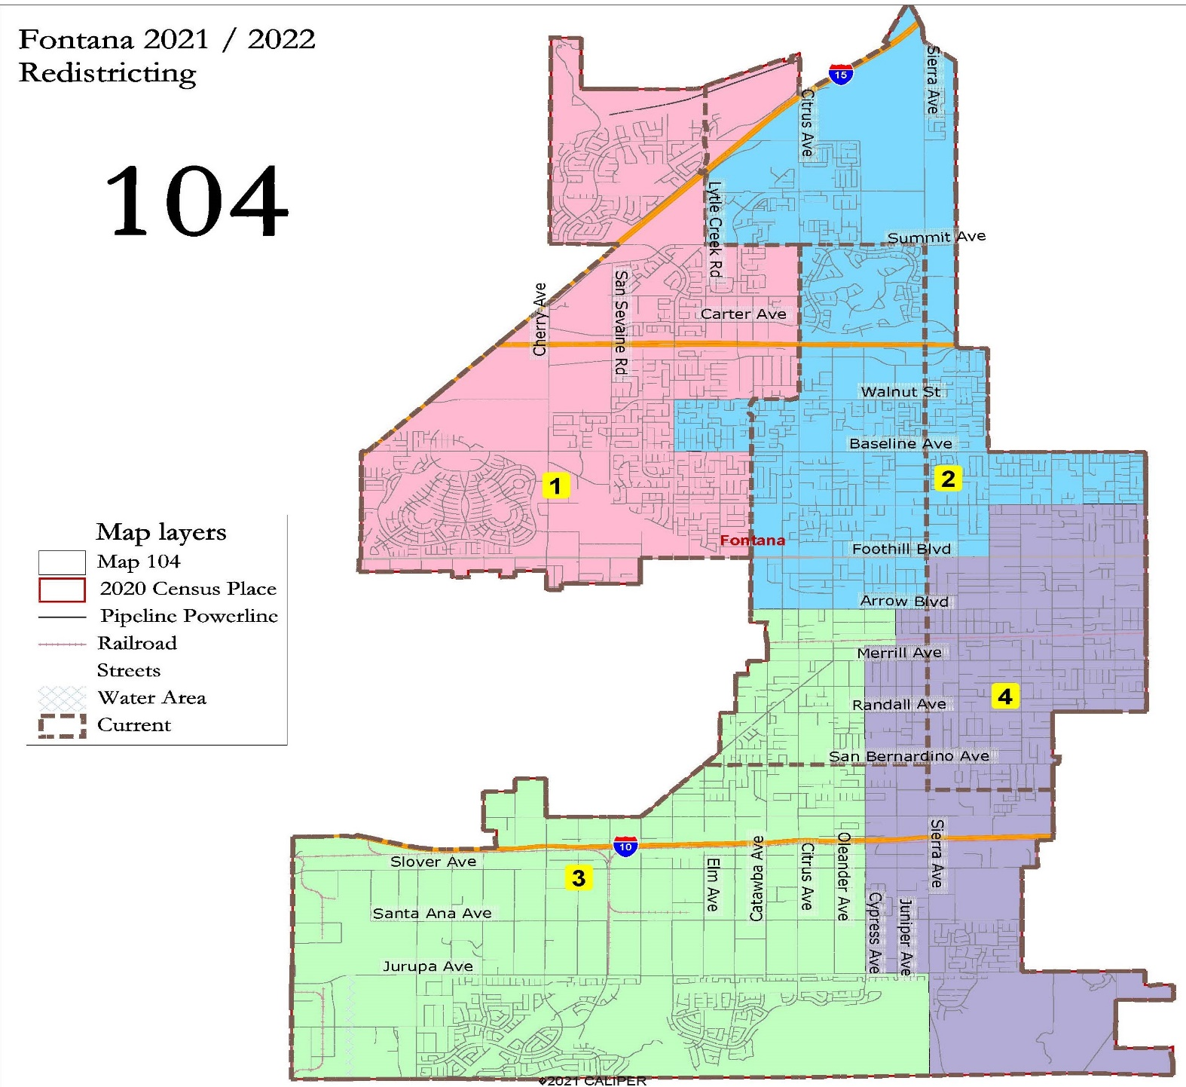
Public Map 104

Slide 12
Public Map 104 Demographics
Fontana Public Map 104
District |  | 1 | 2 | 3 | 4 | Total
 | Total Pop | 51,169 | 52,337 | 52,964 | 52,590 | 209,060
 | Deviation from ideal | -1,096 | 72 | 699 | 325 | 1,795
 | % Deviation | -2.10% | 0.14% | 1.34% | 0.62% | 3.43%
Total Pop | % Hisp | 47.5% | 64% | 79% | 80% | 68%
 | % NH White | 20% | 12% | 7% | 10% | 12%
 | % NH Black | 14% | 10% | 7% | 5% | 9%
 | % Asian-American | 16% | 11% | 5% | 3% | 9%
Citizen Voting Age Pop | Total | 33,243 | 28,618 | 31,391 | 28,345 | 121,597
 | % Hisp | 48% | 63% | 73% | 69% | 63%
 | % NH White | 22% | 18% | 12% | 18% | 18%
 | % NH Black | 17% | 9% | 11% | 8% | 11%
 | % Asian/Pac.Isl. | 10% | 10% | 3% | 4% | 7%
Voter Registration (Nov 2020) | Total | 30,251 | 26,653 | 23,739 | 22,324 | 102,967
 | % Latino est. | 44% | 59% | 71% | 71% | 60%
 | % Spanish-Surnamed | 40% | 54% | 64% | 64% | 54%
 | % Asian-Surnamed | 5% | 4% | 2% | 2% | 3%
 | % Filipino-Surnamed | 3% | 3% | 2% | 1% | 2%
 | % NH White est. | 30% | 25% | 17% | 23% | 24%
 | % NH Black | 21% | 13% | 13% | 9% | 15%
Voter Turnout (Nov 2020) | Total | 24,220 | 19,791 | 16,780 | 15,315 | 76,106
 | % Latino est. | 43% | 57% | 69% | 69% | 57%
 | % Spanish-Surnamed | 39% | 52% | 63% | 62% | 52%
 | % Asian-Surnamed | 4% | 4% | 2% | 2% | 3%
 | % Filipino-Surnamed | 3% | 3% | 2% | 1% | 2%
 | % NH White est. | 31% | 26% | 17% | 24% | 25%
 | % NH Black | 22% | 14% | 14% | 10% | 16%

Slide 13
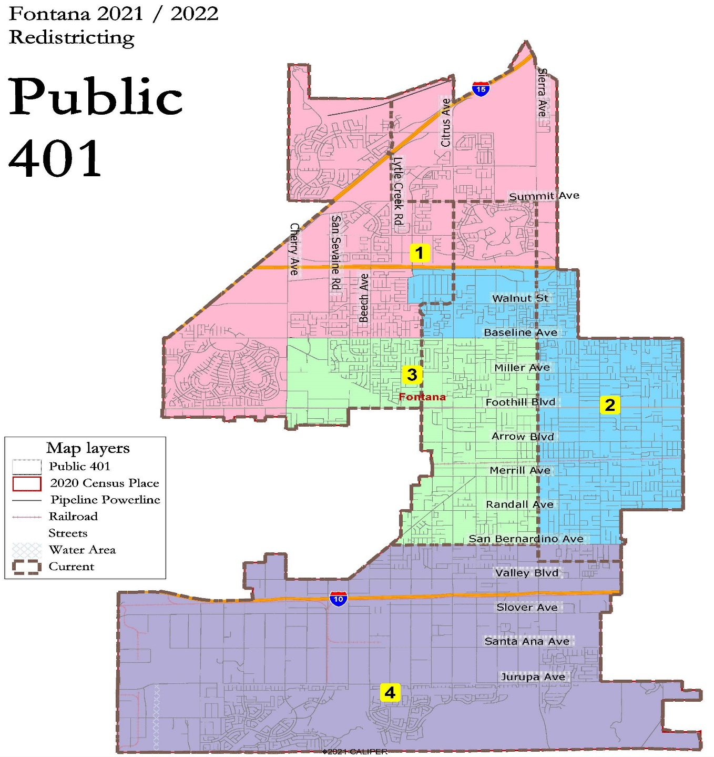
Public Map 401

Slide 14
Public Map 401 Demographics
Fontana Public Map 401
District |  | 1 | 2 | 3 | 4 | Total
 | Total Pop | 53,311 | 52,670 | 52,266 | 50,813 | 209,060
 | Deviation from ideal | 1,046 | 405 | 1 | -1,452 | 2,498
 | % Deviation | 2.00% | 0.77% | 0.00% | -2.78% | 4.78%
Total Pop | % Hisp | 43.0% | 75% | 78% | 76% | 68%
 | % NH White | 22% | 11% | 8% | 9% | 12%
 | % NH Black | 15% | 7% | 7% | 7% | 9%
 | % Asian-American | 17% | 5% | 5% | 7% | 9%
Citizen Voting Age Pop | Total | 34,282 | 29,061 | 26,112 | 32,141 | 121,597
 | % Hisp | 43% | 70% | 74% | 69% | 63%
 | % NH White | 26% | 15% | 14% | 14% | 18%
 | % NH Black | 17% | 8% | 8% | 11% | 11%
 | % Asian/Pac.Isl. | 12% | 5% | 3% | 5% | 7%
Voter Registration (Nov 2020) | Total | 32,757 | 24,737 | 21,065 | 24,408 | 102,967
 | % Latino est. | 41% | 69% | 69% | 69% | 60%
 | % Spanish-Surnamed | 37% | 62% | 63% | 62% | 54%
 | % Asian-Surnamed | 5% | 2% | 2% | 3% | 3%
 | % Filipino-Surnamed | 3% | 2% | 2% | 2% | 2%
 | % NH White est. | 33% | 22% | 20% | 18% | 24%
 | % NH Black | 20% | 11% | 12% | 14% | 15%
Voter Turnout (Nov 2020) | Total | 26,526 | 17,405 | 14,425 | 17,750 | 76,106
 | % Latino est. | 40% | 66% | 67% | 67% | 57%
 | % Spanish-Surnamed | 36% | 61% | 61% | 61% | 52%
 | % Asian-Surnamed | 5% | 2% | 2% | 3% | 3%
 | % Filipino-Surnamed | 3% | 2% | 2% | 2% | 2%
 | % NH White est. | 34% | 23% | 21% | 18% | 25%
 | % NH Black | 20% | 12% | 12% | 15% | 16%

Slide 15
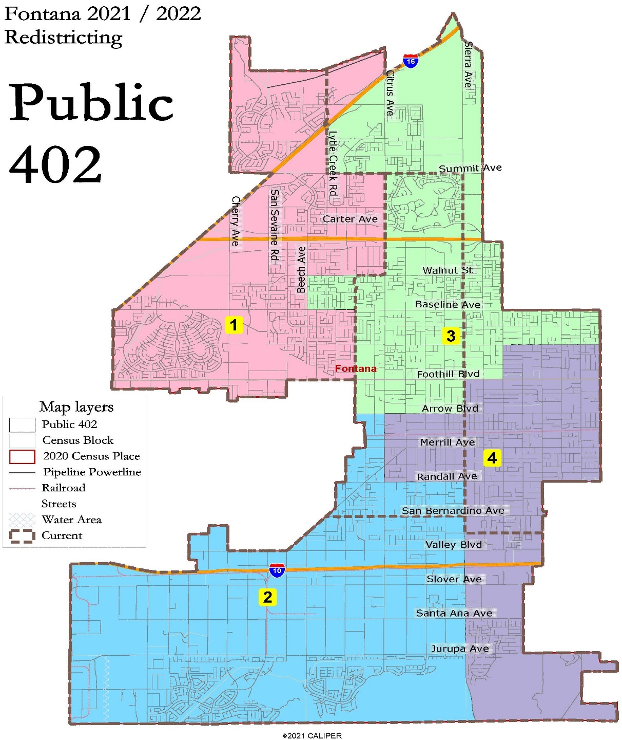
Public Map 402

Slide 16
Public Map 402 Demographics
Fontana Public Map 402
District |  | 1 | 2 | 3 | 4 | Total
 | Total Pop | 51,169 | 51,810 | 52,337 | 53,744 | 209,060
 | Deviation from ideal | -1,096 | -455 | 72 | 1,479 | 2,575
 | % Deviation | -2.10% | -0.87% | 0.14% | 2.83% | 4.93%
Total Pop | % Hisp | 47.5% | 78% | 64% | 80% | 68%
 | % NH White | 20% | 8% | 12% | 10% | 12%
 | % NH Black | 14% | 7% | 10% | 5% | 9%
 | % Asian-American | 16% | 5% | 11% | 3% | 9%
Citizen Voting Age Pop | Total | 33,243 | 31,731 | 28,618 | 28,004 | 121,597
 | % Hisp | 48% | 72% | 63% | 70% | 63%
 | % NH White | 22% | 13% | 18% | 17% | 18%
 | % NH Black | 17% | 11% | 9% | 8% | 11%
 | % Asian/Pac.Isl. | 10% | 4% | 10% | 4% | 7%
Voter Registration (Nov 2020) | Total | 30,251 | 23,892 | 26,653 | 22,171 | 102,967
 | % Latino est. | 44% | 71% | 59% | 71% | 60%
 | % Spanish-Surnamed | 40% | 64% | 54% | 64% | 54%
 | % Asian-Surnamed | 5% | 2% | 4% | 1% | 3%
 | % Filipino-Surnamed | 3% | 2% | 3% | 1% | 2%
 | % NH White est. | 30% | 18% | 25% | 22% | 24%
 | % NH Black | 21% | 13% | 13% | 9% | 15%
Voter Turnout (Nov 2020) | Total | 24,220 | 17,052 | 19,791 | 15,043 | 76,106
 | % Latino est. | 43% | 69% | 57% | 69% | 57%
 | % Spanish-Surnamed | 39% | 63% | 52% | 63% | 52%
 | % Asian-Surnamed | 4% | 2% | 4% | 1% | 3%
 | % Filipino-Surnamed | 3% | 2% | 3% | 1% | 2%
 | % NH White est. | 31% | 18% | 26% | 23% | 25%
 | % NH Black | 22% | 14% | 14% | 9% | 16%

Slide 17
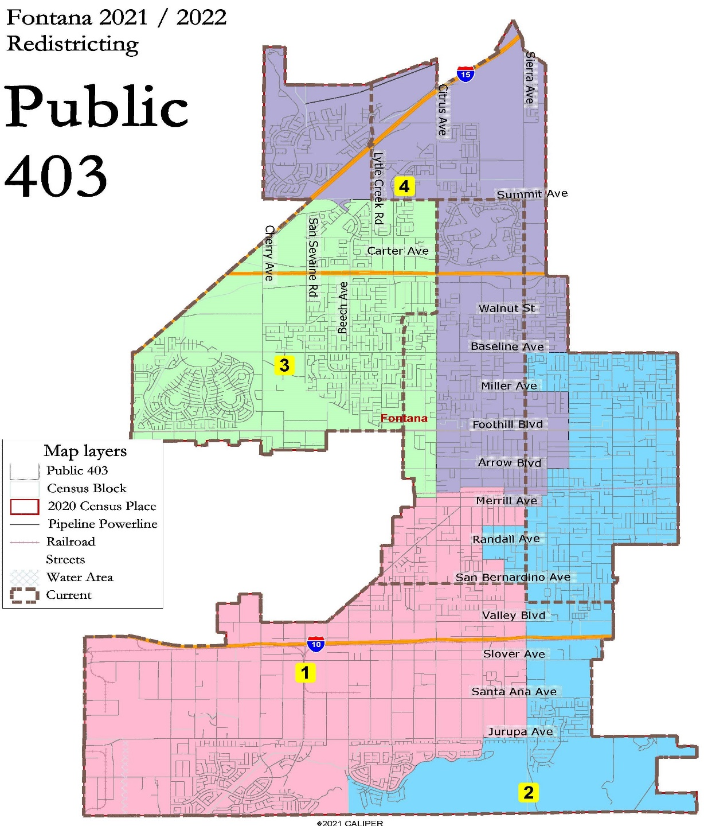
Public Map 403

Slide 18
Public Map 403 Demographics
Fontana Public Map 403
District |  | 1 | 2 | 3 | 4 | Total
 | Total Pop | 52,287 | 52,258 | 52,231 | 52,284 | 209,060
 | Deviation from ideal | 22 | -7 | -34 | 19 | 56
 | % Deviation | 0.04% | -0.01% | -0.07% | 0.04% | 0.11%
Total Pop | % Hisp | 79.4% | 78% | 52% | 62% | 68%
 | % NH White | 8% | 10% | 17% | 15% | 12%
 | % NH Black | 6% | 6% | 13% | 11% | 9%
 | % Asian-American | 5% | 4% | 15% | 11% | 9%
Citizen Voting Age Pop | Total | 31,627 | 28,515 | 32,806 | 28,649 | 121,597
 | % Hisp | 74% | 67% | 54% | 56% | 63%
 | % NH White | 13% | 18% | 18% | 23% | 18%
 | % NH Black | 9% | 9% | 17% | 11% | 11%
 | % Asian/Pac.Isl. | 3% | 5% | 9% | 10% | 7%
Voter Registration (Nov 2020) | Total | 23,689 | 23,449 | 29,753 | 26,076 | 102,967
 | % Latino est. | 72% | 71% | 48% | 54% | 60%
 | % Spanish-Surnamed | 65% | 64% | 43% | 49% | 54%
 | % Asian-Surnamed | 2% | 2% | 5% | 4% | 3%
 | % Filipino-Surnamed | 2% | 2% | 3% | 3% | 2%
 | % NH White est. | 18% | 22% | 26% | 30% | 24%
 | % NH Black | 12% | 10% | 22% | 14% | 15%
Voter Turnout (Nov 2020) | Total | 16,710 | 16,343 | 23,371 | 19,682 | 76,106
 | % Latino est. | 70% | 69% | 46% | 51% | 57%
 | % Spanish-Surnamed | 64% | 62% | 42% | 46% | 52%
 | % Asian-Surnamed | 2% | 2% | 4% | 4% | 3%
 | % Filipino-Surnamed | 2% | 2% | 3% | 3% | 2%
 | % NH White est. | 18% | 23% | 27% | 32% | 25%
 | % NH Black | 13% | 10% | 22% | 14% | 16%

Slide 19
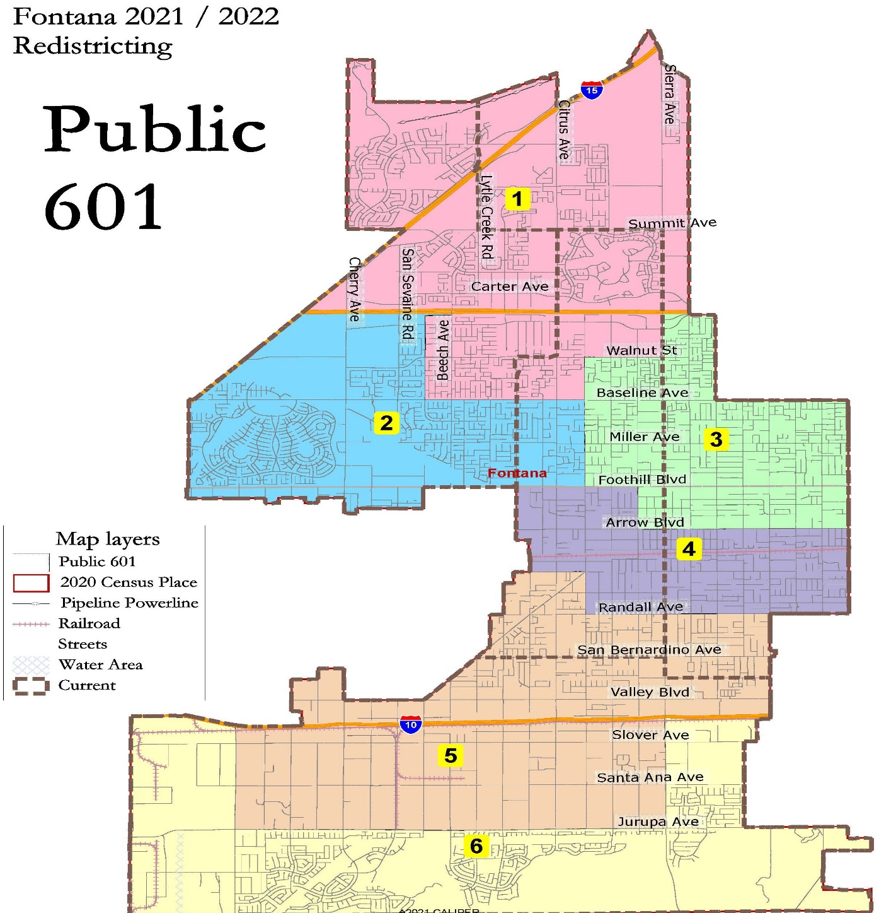
Public Map 601

Slide 20
Public Map 601 Demographics
Fontana Public Map 601
District |  | 1 | 2 | 3 | 4 | 5 | 6 | Total
 | Total Pop | 40,289 | 34,501 | 35,437 | 33,102 | 32,800 | 32,931 | 209,060
 | Deviation from ideal | 5,446 | -342 | 594 | -1,741 | -2,043 | -1,912 | 7,489
 | % Deviation | 15.63% | -0.98% | 1.70% | -5.00% | -5.86% | -5.49% | 21.49%
Total Pop | % Hisp | 43.9% | 55% | 75% | 83% | 83% | 72% | 68%
 | % NH White | 22% | 16% | 9% | 8% | 9% | 8% | 12%
 | % NH Black | 14% | 12% | 8% | 6% | 4% | 9% | 9%
 | % Asian-American | 17% | 14% | 6% | 2% | 3% | 8% | 9%
Citizen Voting Age Pop | Total | 24,821 | 22,080 | 19,501 | 15,310 | 18,886 | 20,999 | 121,597
 | % Hisp | 44% | 55% | 72% | 76% | 74% | 65% | 63%
 | % NH White | 27% | 18% | 13% | 16% | 17% | 12% | 18%
 | % NH Black | 14% | 17% | 9% | 6% | 5% | 15% | 11%
 | % Asian/Pac.Isl. | 14% | 8% | 6% | 1% | 2% | 7% | 7%
Voter Registration (Nov 2020) | Total | 24,266 | 19,512 | 16,485 | 12,008 | 13,554 | 17,142 | 102,967
 | % Latino est. | 42% | 50% | 70% | 73% | 75% | 67% | 60%
 | % Spanish-Surnamed | 38% | 46% | 63% | 66% | 68% | 60% | 54%
 | % Asian-Surnamed | 5% | 4% | 2% | 1% | 1% | 3% | 3%
 | % Filipino-Surnamed | 3% | 3% | 2% | 1% | 1% | 2% | 2%
 | % NH White est. | 35% | 25% | 20% | 22% | 23% | 15% | 24%
 | % NH Black | 18% | 21% | 12% | 8% | 5% | 18% | 15%
Voter Turnout (Nov 2020) | Total | 19,653 | 15,242 | 11,422 | 7,787 | 9,154 | 12,848 | 76,106
 | % Latino est. | 41% | 49% | 68% | 71% | 74% | 65% | 57%
 | % Spanish-Surnamed | 37% | 44% | 62% | 64% | 67% | 59% | 52%
 | % Asian-Surnamed | 5% | 4% | 2% | 1% | 1% | 3% | 3%
 | % Filipino-Surnamed | 3% | 3% | 2% | 1% | 1% | 3% | 2%
 | % NH White est. | 36% | 25% | 21% | 24% | 23% | 16% | 25%
 | % NH Black | 18% | 22% | 12% | 8% | 5% | 19% | 16%

Slide 21
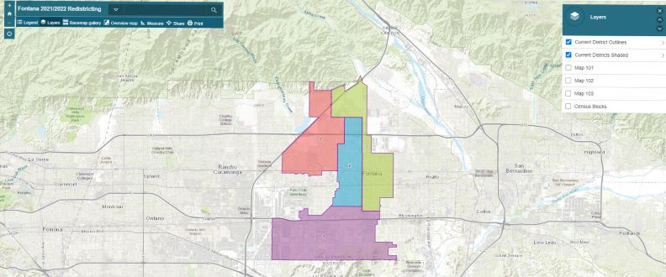
Simple Map Review Tool
Online Interactive Review Map
ESRI’s “ArcGIS Online” – similar to Google Maps in ease of use
Used to review, analyze and compare maps, not to create them
Includes overlays of “community of interest” and other data

Slide 22
Discussion
Conduct a Public Hearing
Any questions on the Draft Maps?
Provide direction on what map the Council prefers or new map the Council would like see at the next hearing

